Slide 1
Vrinda Store Annual Report

Slide 2

Objective
Vrinda Store wants to create an annual sales report for 2023 ,so that vrinda can understand their customers and can grow more their business in next year.

Slide 3
Requirements
Compare the Sales and orders using single chart.
Which month got the highest Sales and orders
Who purchased more – men or women in 2023?
What are the different order Status in 2023?
List the Top States contributing to the sales?
Relation Between age and gender based on numbers orders.
Which channel is contributing to maximum Sales ?
Highest Selling category?

Slide 4
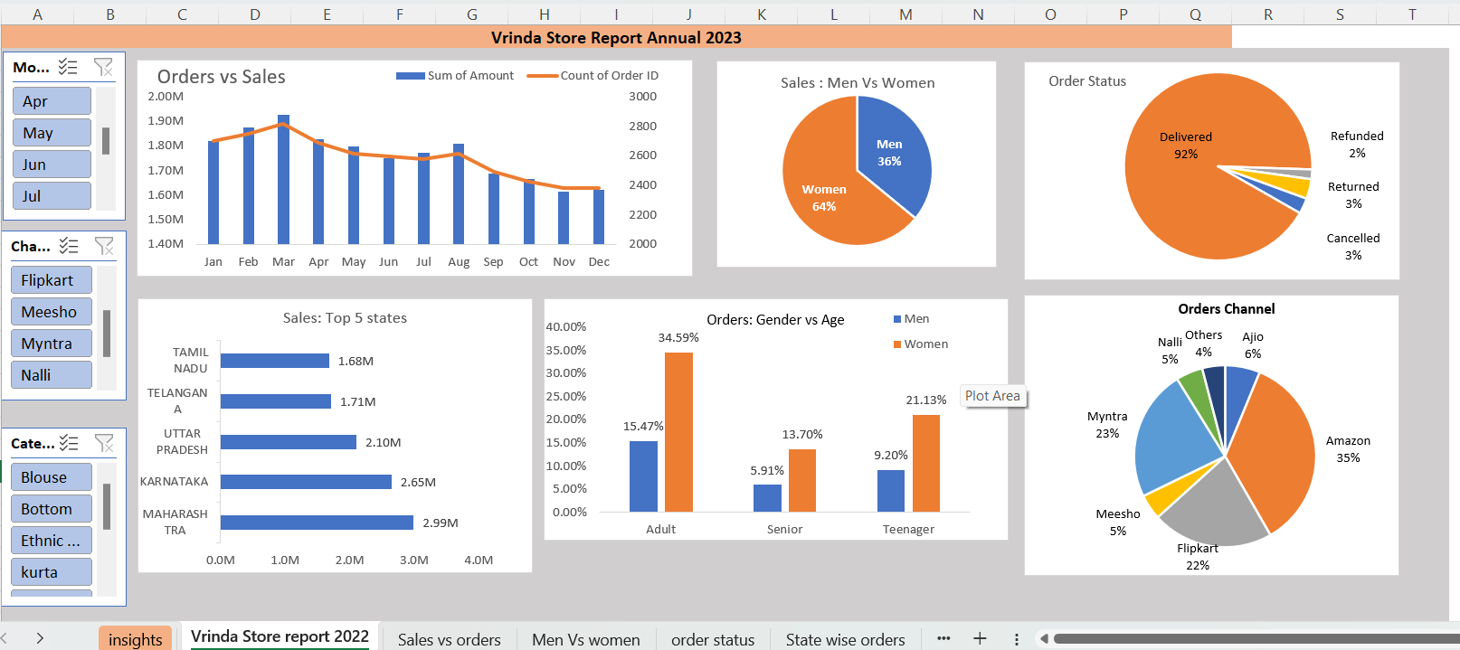
Final Dashboard

Slide 5
Insights
Women are more likely to buy compared to more (~65%)
Maharastra, Karnataka and UP are Top 3 states (~35%)
Adult age group (30-49 years) is max contributing (~50%)
Amazon, flipkart and Myntra channels are max contributing (~80%)

Slide 6
Final conclusion to improve Vrindra Store sales -:
Target women customers of age group (30-49 yrs) living in Maharstra, Karnataka and UP by showing ads/offers/coupons available on Amazon ,flipkart and Myntra.

Slide 7
Thank You!

